Slide 1
Preparation for the operational case study EAWS-Practitioner
EAWS-Practitioner

Slide 2
Introduction
Together with you, we would like to prove the benefits of the EAWS application by means of operational case studies, demonstrating an increase in productivity and ergonomic optimization. The operational case study can be chosen by you. The optimization is done by yourself under the guidance of an experienced EAWS instructor. We will be happy to support you later in the operational implementation.
The training is conducted in individual webinar sessions. Divided into Active and Passive Sessions. During the Passive Session, the instructor will be available to answer your questions personally.
In order for the operational case study to be successful, we ask that you prepare the information contained in the next slides to present to your colleagues and instructors on the first day of the course.
The operational case study is the introduction and runs through the entire training. Every day another puzzle piece is added. On the last day there is a final presentation.

Slide 3
Selection of an operational case study
Please find an example of an operational case with the appropriate framework conditions:
The focus is on the EAWS assessment of one person for a shift length of approx. 480 minutes.
Time per work cycle / takt:
t_{e} = approx. 0.5 - 0.8 min (MTM-1)
t_{e} = approx. 2 min (MTM-SD)
t_{e} = approx. 3 - 5 min (MTM-UAS)
For MTM-MEK, the amount of work should be more than 6 min.
REFA times or estimated times may also be used.
The company case study should be realizable in the own company (the presentation should be presented in the company after the EAWS-Practitioner training).

Slide 4
Create project order
Please fill in the following information in the appropriate fields. On the next slide you will find an example of how to fill in.
Initial situation, problems, tasks
Project scope
Benefits, goals, score values
Team, Dates, Budget

Slide 5
Example - Project order
Initial situation, problems, tasks
Initial situation: Finished parts are checked and packed in the XX assembly line. Problem: The weight of the parts varies between 3 and 10 kg. The employees have physical complaints. Tasks: Determination of the ergonomic load with EAWS Derivation of design measures Proof of the reduction of the ergonomic risk
Project scope
In the project scope: Consideration of the control and packaging workplace Elaboration of the project order according to the MTM method and ergonomic guidelines Not in the project scope: Consideration of workplaces outside the specified system limits
Benefits, goals, score values
Benefit: Improvement of ergonomic working conditions Improvement of work processes Objectives: Reduce the ergonomic risk at the workplace while taking economic aspects into account. Measurement parameters: EAWS risk assessment
Team, Dates, Budget
Team: Mr. VVVV HHHH, N.N (MTM ASSOCIATION), Dr. JJJJJ JJJJ Dates: Starts: dd.mm.yyyy End: dd.mm.yyyy

Slide 6
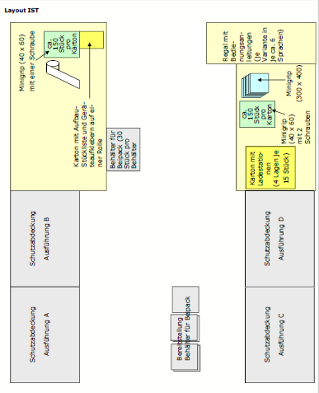
Layout
Please insert here a layout for the case study.
Example:

Slide 7
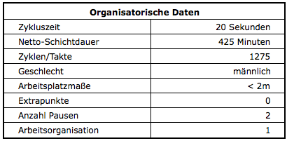
Organisational and technical data
Please insert the necessary organizational and technical data for your case study here.
Example:
* 1 = Interruptions possible within given framework conditions

Slide 8
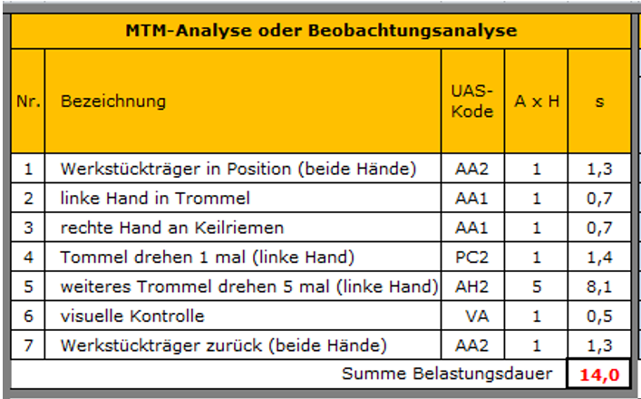
Workflow / working method
Please insert here the workflow/method of work in an appropriate form for your case study.
Example:

Slide 9
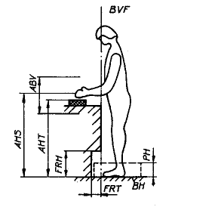
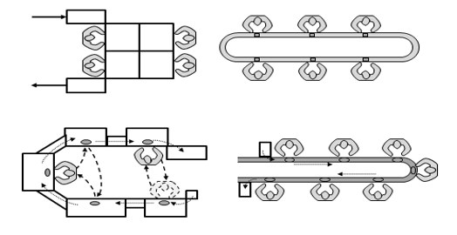
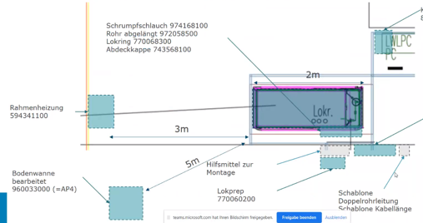
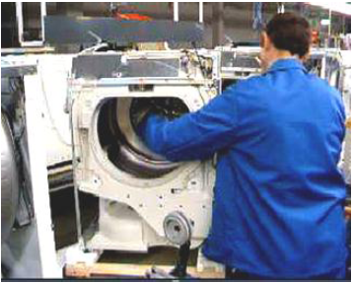
Further information
Please add further information (explanations, process principle, pictures, video...) for your case study here.

